Slide 1

NextHikes IT Solutions
Bike Rental Insights
Presented by Sanju Kumavat, Intern Data Analyst/ Data Scientist

Slide 2
Introduction
Overview of Bike Rental Insights
Project Name – Bike Rental Dashboard
Objective : To Analyze short term bike rentals data (Jan 1 to Feb 14) and uncover usage patterns, user behaviors, and environmental impact
Data Source : Daily rental dataset with user type, weather, weekday, holiday and environmental factors

Slide 3
58,304
Total Rentals
The total rentals from January 1 to February 14 indicate a consistent short-term demand, showcasing the popularity of the bike rental service among users during this period.

Slide 4
User Type Distribution
Casual Users
Insights on Casual vs. Registered Users
Casual users account for 4,921 rentals, representing 8.44% of total usage. This group primarily seeks flexibility and convenience, showing potential for targeted engagement strategies.
Registered Users
Registered users comprise 53,383 rentals, making up 91.56% of total rentals. Their loyalty indicates a strong base for retention marketing efforts, which can enhance overall business performance.

Slide 5
Peak Usage Patterns
Peak Weekday
Insights into rental behavior trends
The highest rental activity occurs on Fridays, indicating a strong preference for users to initiate weekend activities, reflecting a desire to enjoy cycling before the weekend begins.
Peak Weather
Clear weather conditions lead to the highest rental volumes, demonstrating that users are more likely to rent bikes when the skies are clear, favoring enjoyable cycling experiences.

Slide 6
Weather Impact Analysis
Heavy Rain
Rentals drop sharply during heavy rain and mist, indicating users' preference for clear weather conditions.
Clear Weather
Clear weather drives the highest rentals, with approximately 23,000 total rentals recorded during optimal conditions.

Slide 7
Weekday Trends
Understanding Rental Patterns and Effects
Increased Rentals
Saturday Dip
Minimal Holiday Impact
Rentals consistently increase from Sunday to Friday, peaking on Friday. This trend indicates a strong demand leading into the weekend for leisure and commuting purposes.
There is typically a noticeable dip in rentals on Saturdays, likely due to reduced commuting needs as users engage in weekend activities and personal plans.
Holiday rentals comprise only 2% of total rentals, suggesting that marketing efforts should focus on regular weekdays rather than relying on holiday spikes for rental activity.

Slide 8
Environmental Factors
Insights on rental influences
Temperature & Humidity
Rentals are maximized at moderate temperature and humidity levels, while increased windspeed contributes to a decline in rentals, highlighting subtle influences on user behavior and demand.

Slide 9

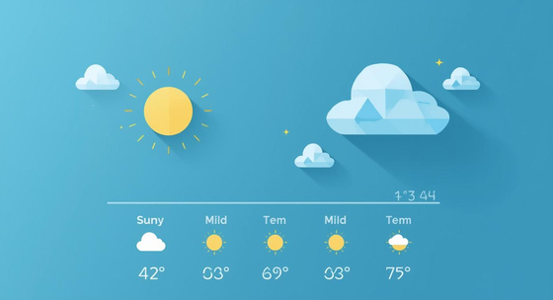

Strategic Insights for Enhanced Bike Rentals
Weekday Focus
Prioritize weekday commuting users to boost rentals.
Weather Optimization
Use forecasts to improve fleet availability efficiently.
Targeted Promotions
Increase marketing efforts on Fridays for high engagement.

Slide 10
Key Insights
Total Rentals : 58304 (Jan 1 – Feb 14)
Registered users dominate (91.56%) vs Casual (8.44%)
Peak usage on Fridays and Clear Weather
Rentals drop during rainy/misty conditions
Environmental Factors influence demand
Conclusion
Key insights and recommendations for success
Recommendations for Success
Focus on strengthening engagement with registered users while creating incentives to convert casual riders. Use Weather and Weekday insights to optimize fleet availability and run targeted promotions on peal and demand days

